Slide 1
Module 9 - Procedural SQL
Extending SQL with Procedural Logic

Slide 2
Learning Outcomes – Procedural SQL (PL/pgSQL)
By the end of this module, you will be able to:
Explain the role of procedural SQL in automating business rules within a relational database.
Create and test triggers and stored procedures using PL/pgSQL in PostgreSQL.

Slide 3

Use Case: Automating Product Reordering
Scenario – SaleCo Inventory Management System
Ensure there are always enough products available for customers.
Automatically trigger a vendor reorder when Quantity on Hand (QoH) falls below the minimum stock level.
How can we automate product reordering using procedural SQL?

Slide 4
Automating Product Ordering
Business Procedure:
Ensure Quantity on Hand (QoH) values are accurate and consistent.
If QoH < Min_Allowable, automatically generate a reorder for that product.
💡 Automation ensures stock levels stay consistent without manual intervention.
Notes:
If we were to automate product ordering, we should somehow implement this procedure.
To implement this procedure, we need to loop through products, and check them for the condition: QOH < min_allowable.
But SQL is declarative not procedural. SQL does not know about loops and conditional execution. →

Slide 5
SQL is Declarative Not Procedural
SQL specifies what to do, not how to do it.
SQL alone does not support conditional logic or looping operations.
To automate business rules, we use a procedural extension such as PL/pgSQL.
💡 Declarative SQL describes the goal; procedural SQL defines the process.

Slide 6
SQL is Declarative Not Procedural
SQL cannot express how to perform operations — only what to do.
As a result, business rules must be duplicated across multiple programs.
This leads to inconsistent logic and high maintenance overhead.
💡 Procedural SQL (PL/pgSQL) allows us to centralize this logic inside the database.
Notes:
What is a good example?

Slide 7
A Better Approach – Centralizing Business Logic
Centralize critical code so all applications call the same shared logic.
Especially effective in distributed and object-oriented systems.
Modern RDBMSs extend SQL with procedural features such as:
  Flow control: IF–THEN–ELSE, LOOP, EXIT WHEN
  Variable declaration & assignment
  Error handling and exceptions
💡 PostgreSQL implements these features through its procedural language, PL/pgSQL.
Notes:
Read Chapter 12 and Appendix G

Slide 8
Procedural SQL

Slide 9
Persistent Stored Modules (PSM)
A Persistent Stored Module (PSM) is a block of SQL and procedural code stored and executed on the DBMS server.
Encapsulates business logic that can be shared and reused across applications.
The SQL:1999 (SQL/PSM) standard defines this concept.
In PostgreSQL, stored functions and procedures written in PL/pgSQL are examples of PSMs.
💬 PSMs centralize logic inside the database — improving consistency and reducing duplication.
Notes:
Where are they stored on sql server?

Slide 10
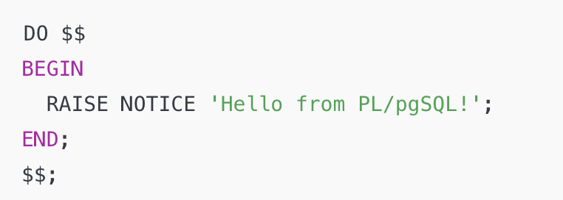
Writing a PL/pgSQL Code Block
Use BEGIN...END to group SQL and procedural statements into one executable block.
Use RAISE NOTICE to display messages and debug your block.
Use RAISE EXCEPTION to handle or test error conditions.
PL/pgSQL blocks form the basis for triggers and stored procedures.
💡 You can run standalone PL/pgSQL blocks using DO $$ ... $$; in pgAdmin.
Notes:
Example?

Slide 11
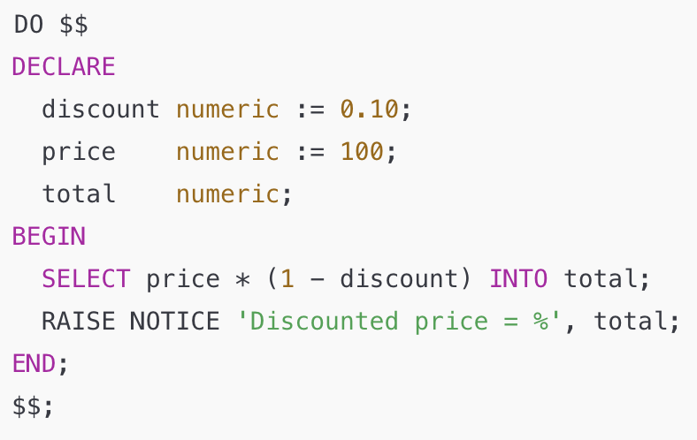
Declaring and Using Variables in PL/pgSQL
Define variables in the DECLARE section before BEGIN.
Each variable has a name, data type, and optional initial value.
Use := to assign values within the block.
Use SELECT ... INTO to assign query results.

Slide 12
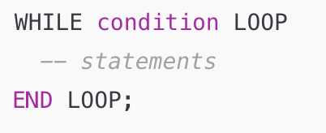
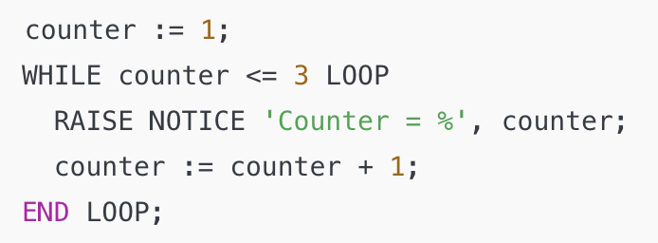
While Loops in PL/pgSQL
A WHILE loop repeats a statement block while a condition is true.
Syntax: Example:

Slide 13
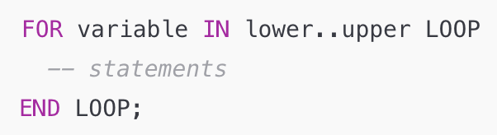
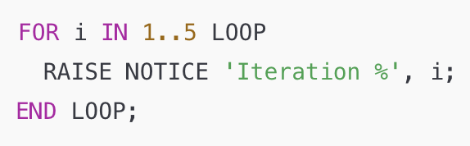
FOR Loops in PL/pgSQL
A FOR loop repeats a block of statements for each value in a range or query result.
Syntax: Example:

Slide 14
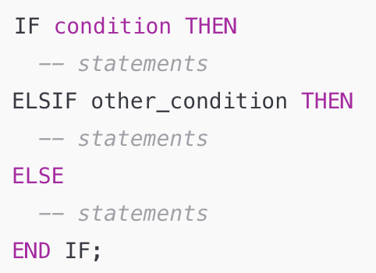
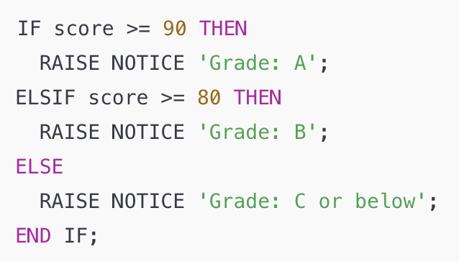
Conditional Logic in PL/pgSQL
Use IF, ELSIF, and ELSE to control flow in your code.
Syntax: Example:

Slide 15
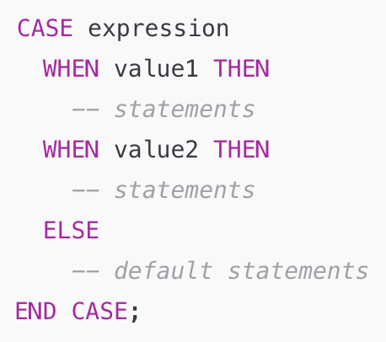
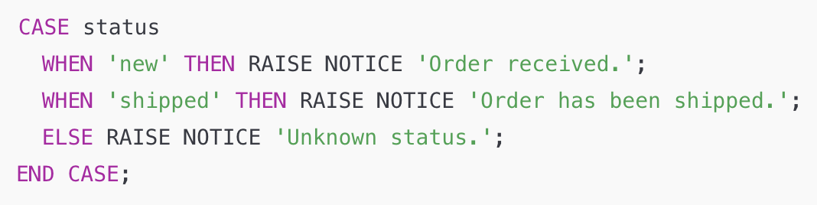
CASE Statements in PL/pgSQL
Use CASE to handle multiple possible values of an expression.
Syntax: Example:

Slide 16
Procedural Language / SQL (PL/pgSQL)
PL/pgSQL merges SQL with programming constructs (variables, loops, conditionals).
Procedural logic can be stored inside the database, not just in applications.
Types of PL/pgSQL code:
  Anonymous blocks (DO $$ ... $$;)
  Triggers (automatic actions)
  Stored procedures (CREATE PROCEDURE)
  Functions (CREATE FUNCTION)
Can be executed directly by users or indirectly through applications.
💬 PL/pgSQL brings programming logic into the database layer for efficiency and consistency.

Slide 17
Triggers – Automating Business Rules in the Database
Triggers let the database react automatically to events like INSERT, UPDATE, or DELETE.
Example: Automatically Reordering Products When Stock Runs Low

Slide 18
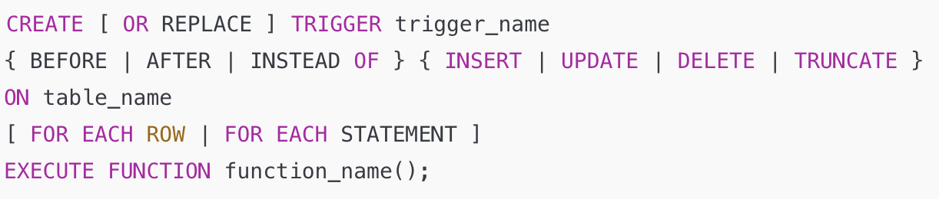
Trigger Syntax in PostgreSQL
Trigger function defines the logic and must return trigger.
BEFORE triggers validate or modify data.
AFTER triggers perform follow-up actions.
Always call a stored function written in PL/pgSQL.
💬 PostgreSQL separates the trigger definition from the trigger logic itself.

Slide 19
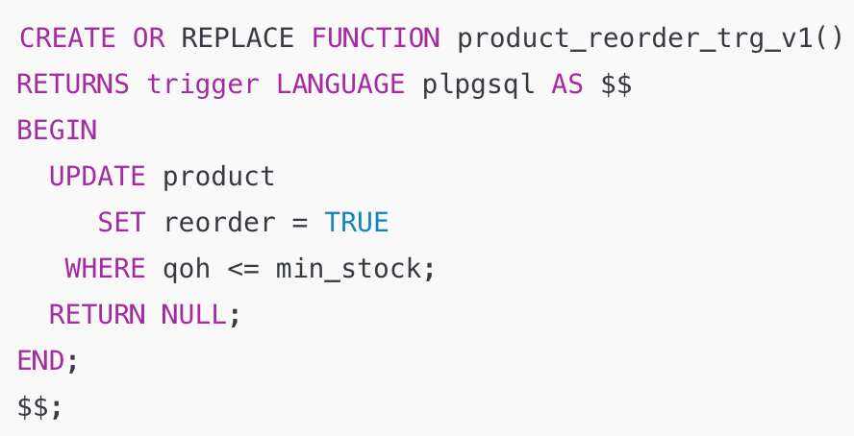
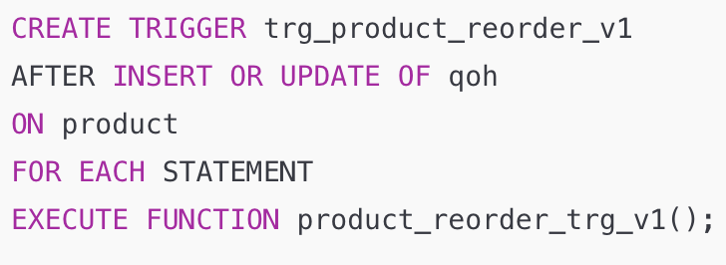
Setting Product Reorder Flag - Version 1
Goal: Automatically mark products for reorder when QOH ≤ MIN_STOCK.
Trigger Function: Trigger Definition:

Slide 20
Components of a Trigger
Trigger Timing
Triggering Events
Trigger Level
Trigger Function
Notes:
Other trigger timings:
AFTER
FOR
INSTEAD OF
Triggering events:
INSERT
UPDATE
DELETE

Slide 21
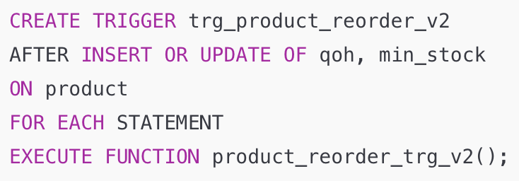
Handling Multiple Triggering Conditions
Changing min_stock should also update the reorder flag.
The previous trigger didn’t respond because only UPDATE OF qoh was included.
✅ Update the trigger to listen for multiple columns:
💬 Now the trigger fires when either quantity or minimum stock level changes.

Slide 22
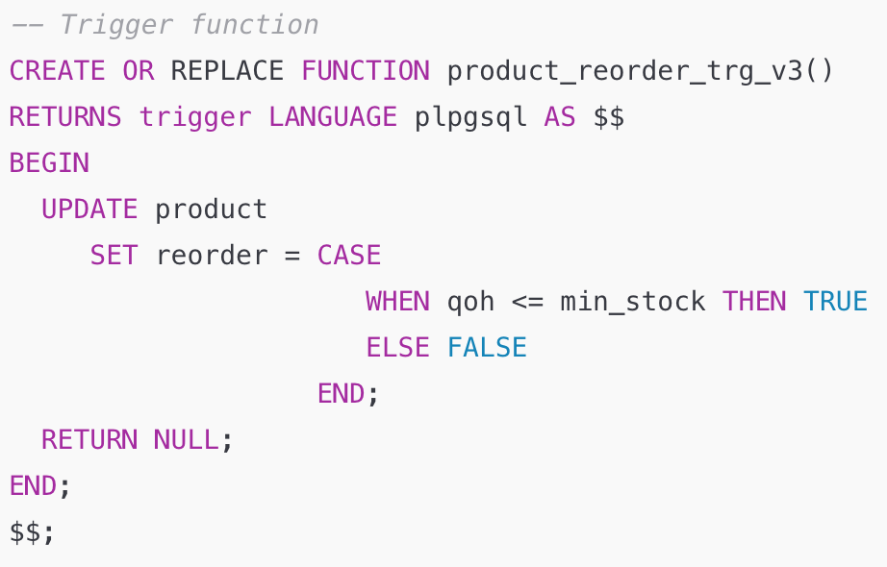
Updating the Trigger Logic with CASE Expressions
Problem: trigger sets reorder to TRUE but never resets it.
Solution: use a CASE expression to handle both conditions.
Notice the use of CASE to compute P_REORDER

Slide 23
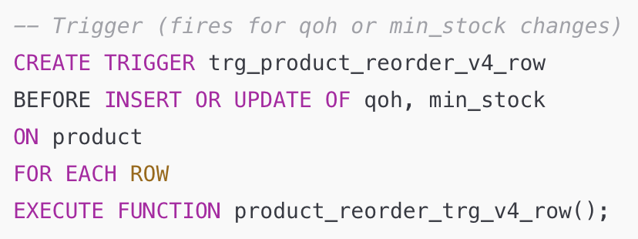
Target Only Affected Rows
Problem: Our current trigger updates all rows in product, not just the ones modified.
Solution:
Use FOR EACH ROW and
set the flag directly on NEW.

Slide 24
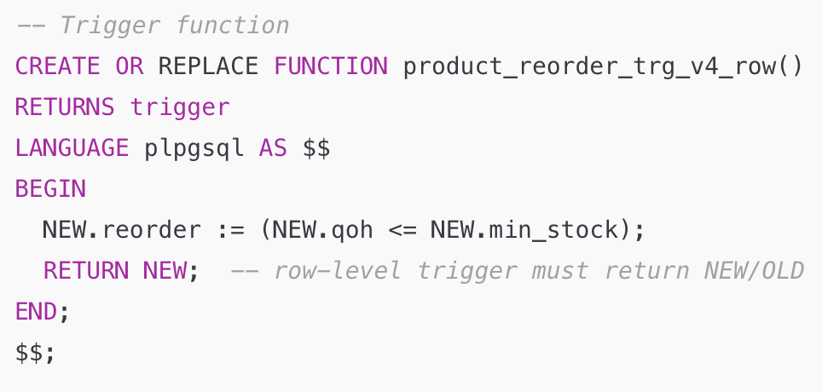
The NEW and OLD Records in Triggers
PostgreSQL provides two pseudo-records inside row-level triggers:
NEW → the new row after the change
OLD → the original row before the change
Used to read or modify values in trigger logic.

Slide 25
Changing Trigger Timing: AFTER → BEFORE
AFTER trigger: runs after the data change — can’t modify the new row.
BEFORE trigger: runs before the change — can adjust the row’s values directly.
Switching to BEFORE lets us set the reorder flag inside NEW without another UPDATE.
💡 Use BEFORE triggers when you want to modify or validate data before it’s stored.

Slide 26
What Is a Trigger?
A trigger is a procedural SQL block that runs automatically when a specified data manipulation event occurs.
It is event-driven — fired by INSERT, UPDATE, or DELETE.
Used to enforce business rules, maintain data integrity, or audit changes automatically.
💬 Triggers make the database proactive — responding to data changes in real time.

Slide 27
Notes on Triggers
Each trigger is linked to a specific table or view.
A table can have multiple triggers for different events or timings.
Trigger actions execute within the same transaction as the triggering event.
Triggers are vital for automating rules and maintaining consistency.
They extend the database’s processing power by embedding logic directly inside the DBMS.
💬 Triggers transform a database from a passive data store into an active, intelligent system.

Slide 28
Automating Product Ordering
The Business Procedure:
Ensure QOH values are up-to-date & consistent
2. If QOH < min_allowable, product must be reordered

Slide 29
Updating an Attribute in Another Table
Business Rule:
When a sale occurs, decrease the Quantity on Hand (QOH) for the sold product.
Implementation:
Trigger on the LINE table updates the PRODUCT table automatically.

Slide 30
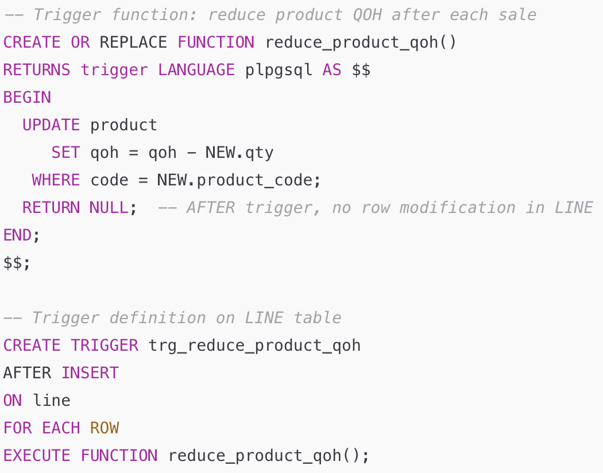
Updating Product QOH Value
TRIGGER on LINE table updates PRODUCT table

Slide 31
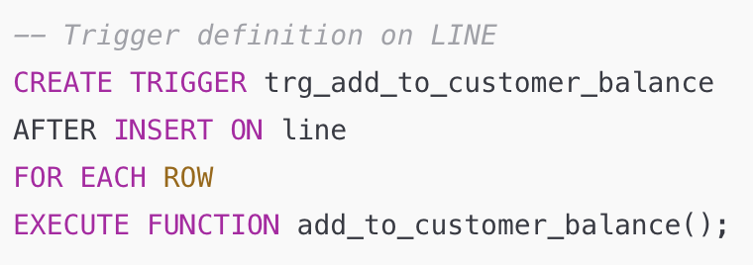
Use of Variables Within a Trigger
We also need to update CUS_BALANCE after inserting every new LINE
→ create a trigger for the LINE table that updates a row in the CUSTOMER table. This time using variables in our trigger function..

Slide 32
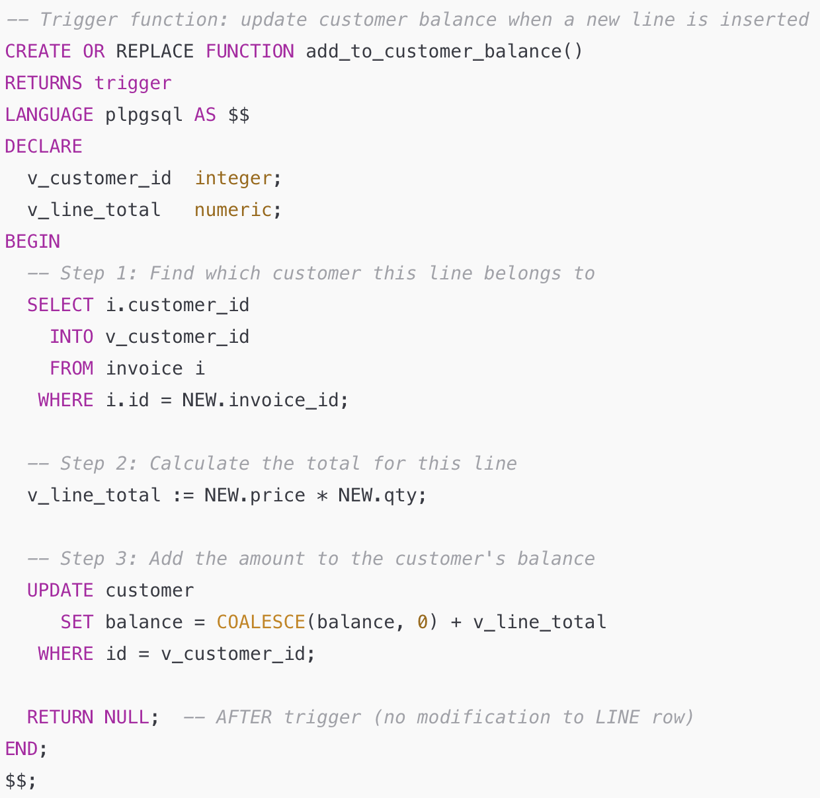
Updating Customer Balance
Need to find the customer and calculate line total in order to update customer balance

Slide 33
Stored Procedures

Slide 34
Stored Procedures in PostgreSQL
A stored procedure is a named PL/pgSQL program stored inside the database.
Like triggers, it resides in the DB and can be reused by multiple applications.
It can encapsulate a complete business transaction, such as:
  Recording a sale
  Updating a customer’s credit limit
  Adding a new product or account
Procedures help centralize logic, ensuring consistent business rules and improving performance.
💬 Procedures are called explicitly — unlike triggers, which run automatically.

Slide 35
Advantages of Stored Procedures
⚡ Reduce network traffic & improve performance
  SQL executes inside the database — no need to transmit statements over the network.
🔁 Reduce code duplication
  Create reusable PL/pgSQL modules that can be called by multiple programs.
🧩 Simplify application development
  Centralize logic to minimize errors and reduce development and maintenance costs.
💬 Stored procedures make applications leaner and databases smarter.

Slide 36
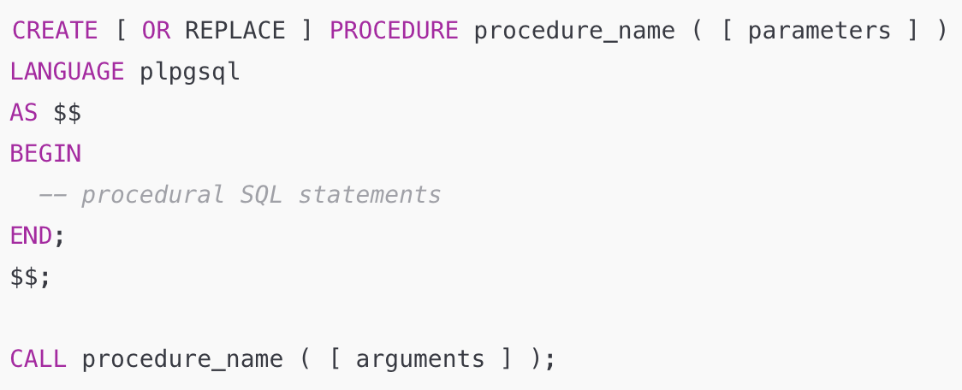
Stored Procedure Syntax (PostgreSQL)
zero or more Parameters passed to procedure

Slide 37
Notes on Stored Procedures
Defined using LANGUAGE plpgsql.
Executed with CALL, not EXEC.
Performs actions but does not return a value.
💬 Use procedures for business operations that modify data or manage transactions.

Slide 38
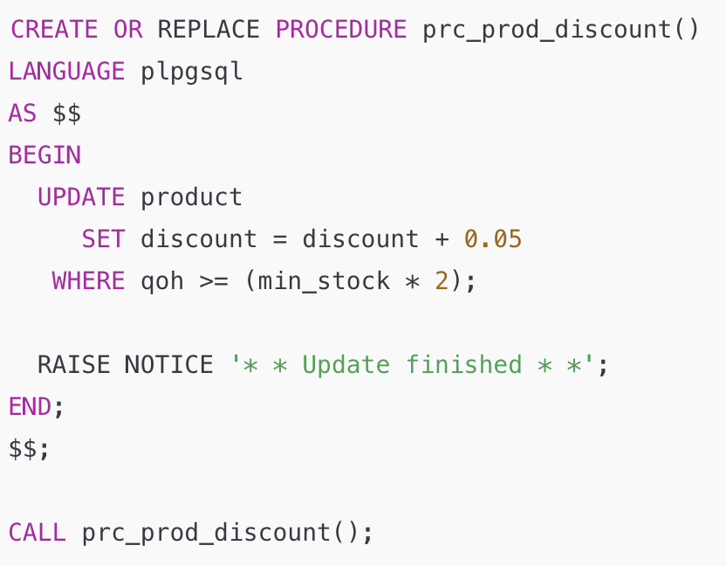
Example – Assign Additional 5% Discount
💬 This stored procedure adjusts product discounts automatically when stock levels are high.

Slide 39
Passing Parameters to Stored Procedures
Stored procedures can accept input parameters, allowing you to:
Make the procedure reusable for different cases.
Avoid hardcoding values (e.g., discount rates, thresholds).
Pass values directly from applications or other SQL code.

Slide 40
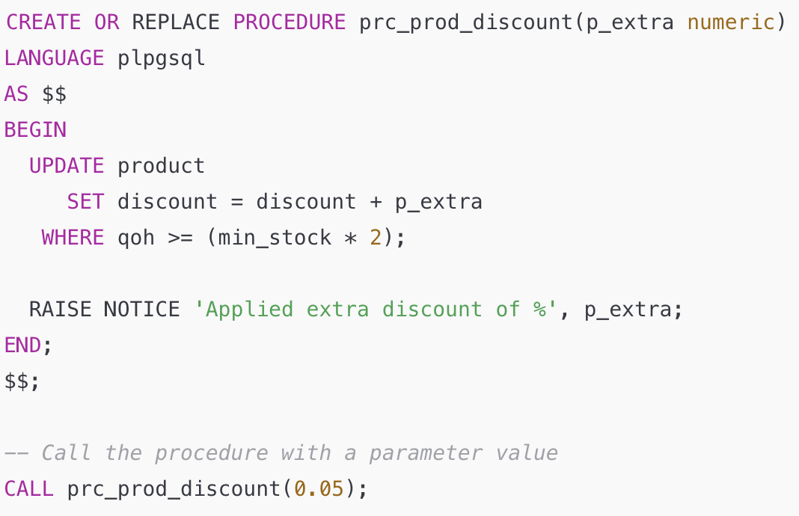
Make discount percentage not a fixed 5% but an input

Slide 41
More Examples

Slide 42
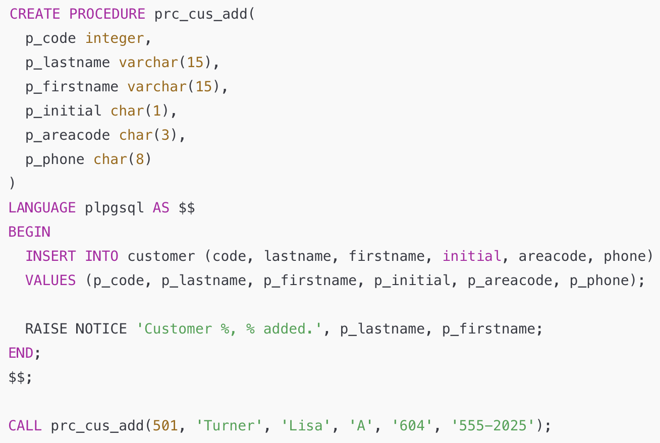
Example – Add a New Customer

Slide 43
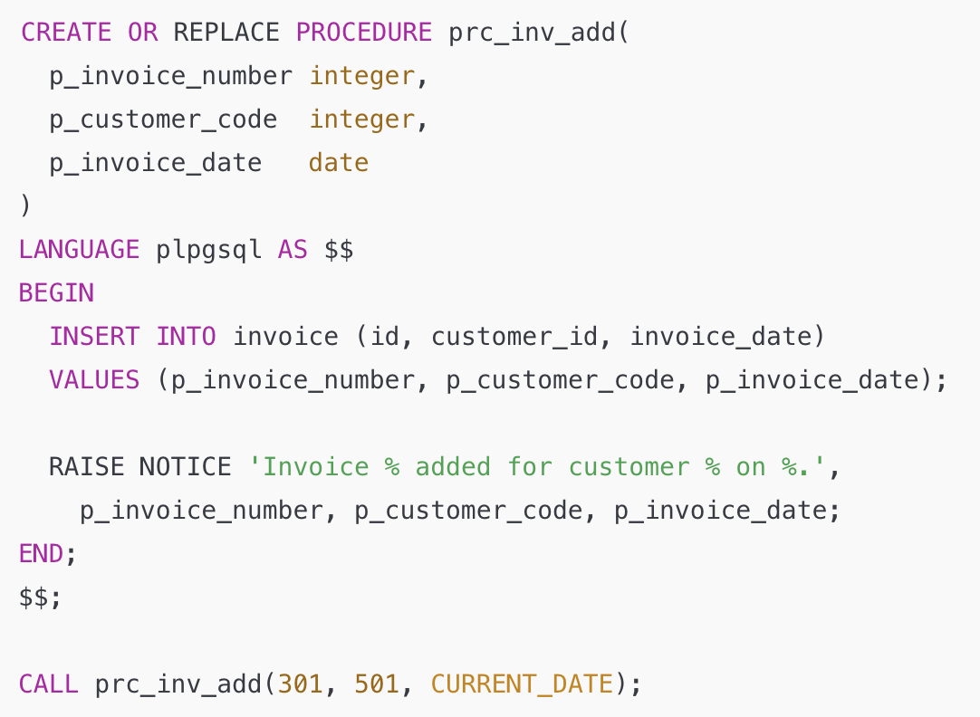
Example – Add a New Invoice

